Slide 1
Duncan Garmonsway
Data Scientist Government Digital Service @nacnudus
Notes:
This is a title side

Slide 2
Customising R Markdown
Notes:
This is what the talk was originally going to be about. I was going to customise R Markdown and then talk about how.

Slide 3
Customising R Markdown
How R Markdown works
Notes:
But then it turned out that the customisations I needed to do went way beyond the official documentation. I had to figure out how markdown works, so then I was going to tell you about that.

Slide 4
Customising R Markdown
How R Markdown works
How to work out how stuff works
Notes:
Most of you won’t ever customise R Markdown. But you might have to customise some other package, so I was going to tell you about how to work out how a package works.

Slide 5
Customising R Markdown
How R Markdown works
How to work out how stuff works
Contribute to {govdown} and the RAP website
Notes:
But really this is all a thinly veiled attempt to get you to maintain the govdown package and write content for the brand new Reproducible Analytical Pipelines website.

Slide 6
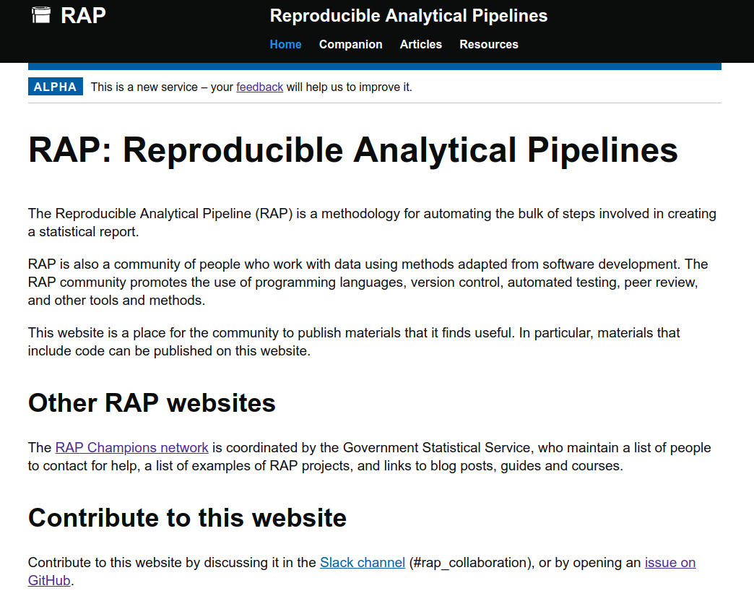
The RAP website is made with
{rmarkdown} and
{govdown}
Notes:
This is the website I would like you to contribute to. It is for the Reproducible Analytical Pipelines community. Raise a hand if you know about RAP. Keep your hand raised if you are working on a RAP project and it has a budget.
RAP is a grassroots community of data analysts, which means it is organised by people with little power and no money. Its assets are the people, the work they do, and the guidance they write for each other. It needed one more asset: a digital home. A website for the community, maintained by the community. That meant some technical constraints:
Built with technology analysts would already know, or would be useful to learn (Python or R)
Accessible

Slide 7
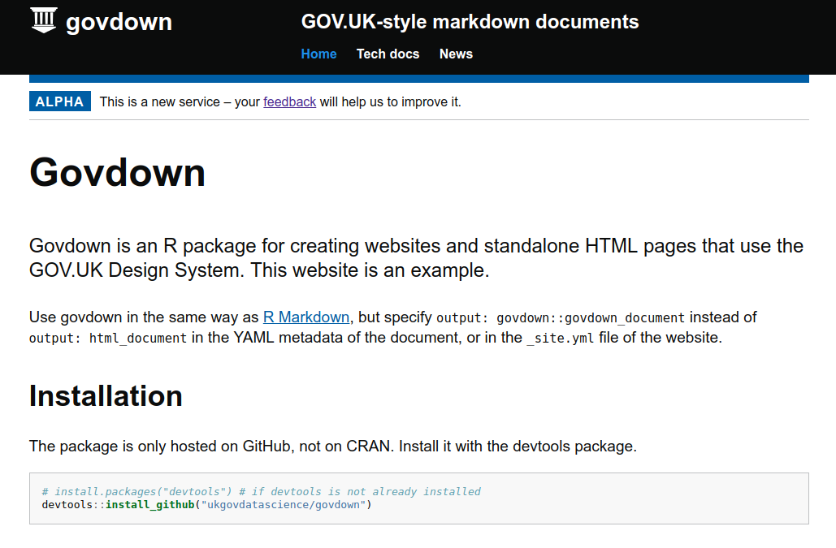
Make accessible websites with {govdown}
Notes:
You can make your own GOV.UK-style website or standalone pages with the new govdown package. It makes it easy to use the GOV.UK Design System.
Use govdown to make accessible websites and standalone HTML pages with the GOV.UK design system.

Slide 8
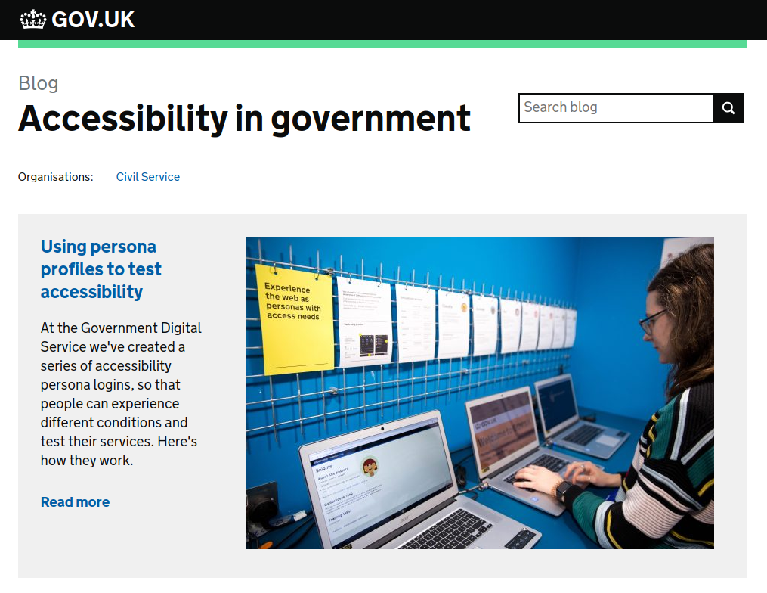
Our websites must be accessible, by law
Notes:
Websites created by the government must meet certain standards, such as WCAG 2.1 (Web Content Accessibility Guidelines). But the real reason to be accessible is because we need everyone in the RAP community to be able to use the website. The Government Digital Service has an empathy lab where you can test the accessibility of your website for people with different permanent, temporary or situational disabilities, limiting one of their senses.
Vision: permanently reduced vision, temporarily lost glasses, phone outside in direct sunshine.
Motor: permanent arthritis, arm in a cast, computer mouse has been stolen.

Slide 9
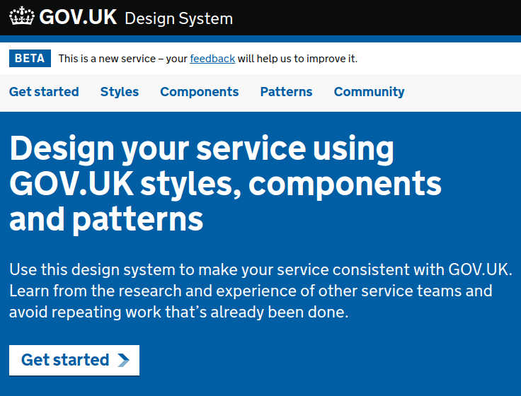
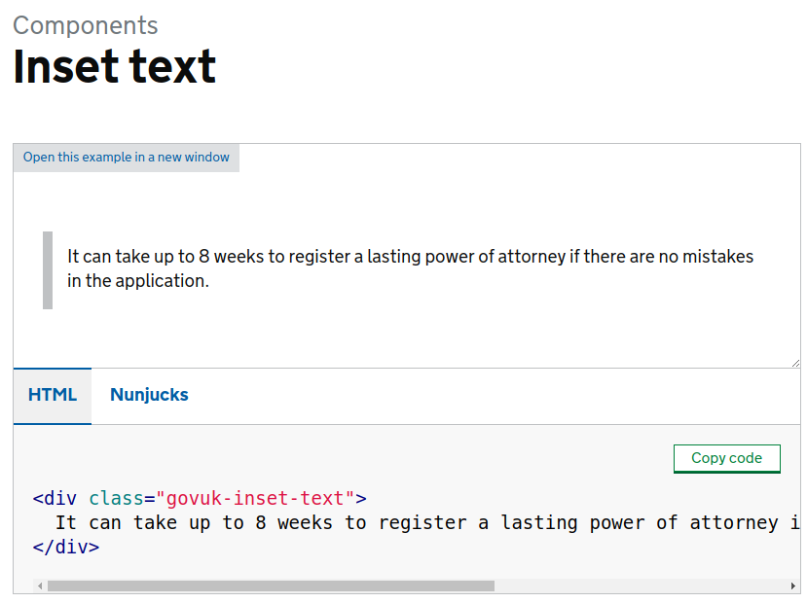
The GOV.UK Design System is accessible
Notes:
The GOV.UK Design System gives you a head start with creating accessible websites. It is a collection of accessible components, from a generic page template, to things like headings, space between paragraphs, and inset text. It gives you the HTML to use in the website.
But HTML is not familiar technology to data analysts. Can we use R Markdown instead?

Slide 10
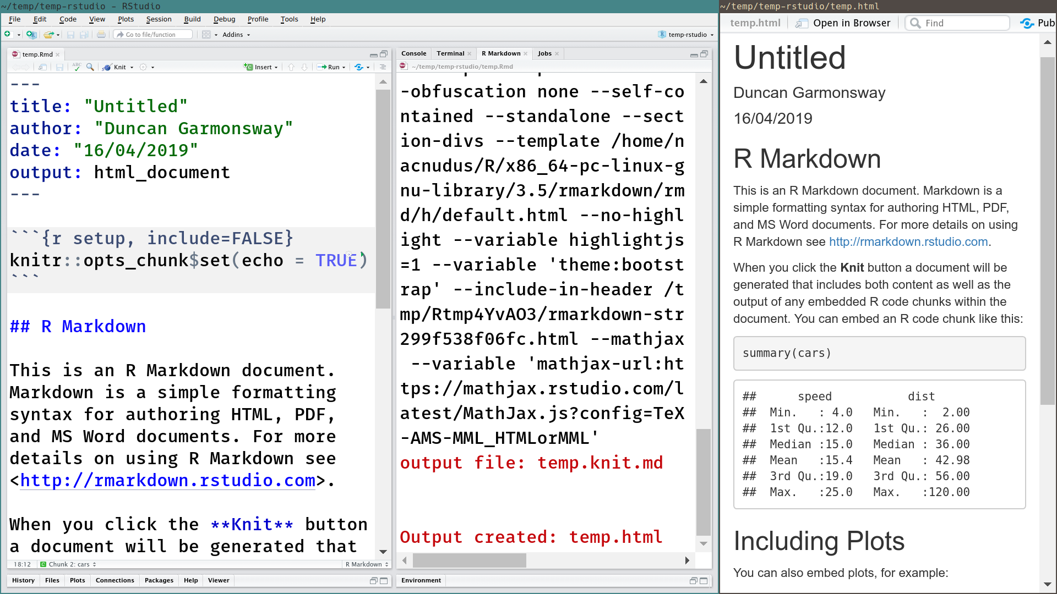
Notes:
A very brief introduction to R Markdown. Raise your hand if you have used R Markdown.
R Markdown is a way to create all kinds of documents, including web pages (HTML) by writing simple plain-text files like the one in the left panel. The colouring is added by RStudio but the file itself is pure text, you could open it in Notepad on Windows. The middle panel shows a long command that was run on the plain text file, outputting an HTML file. The output HTML file is shown in the right-hand panel as a web page.

Slide 11
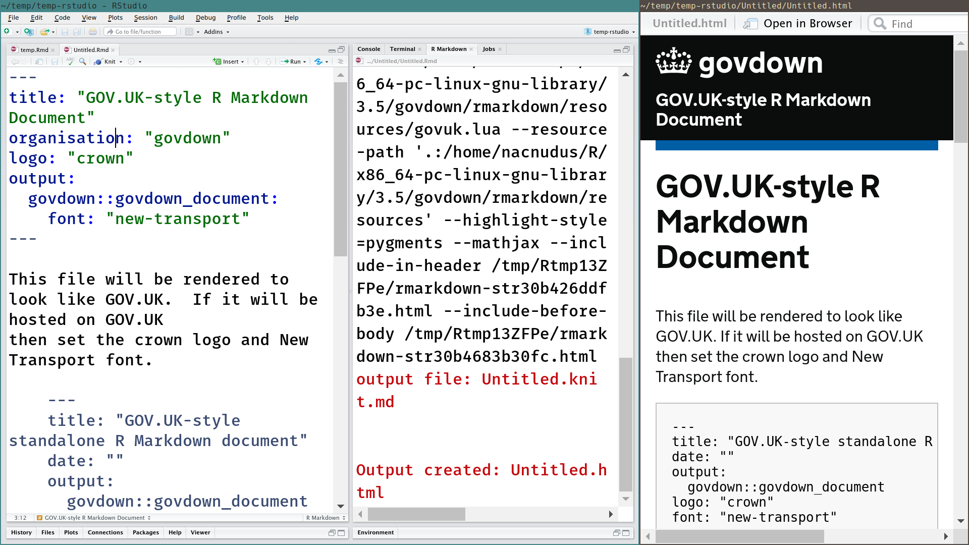
Notes:
Please say “ooooh”
Govdown is a package for you to make web pages and websites that use the GOV.UK Design System to be accessible. They might even look trustworthy. See how easy it is to write normal markdown (left panel), render it as usual (middle panel) and view the resulting web page (right panel).
This particular page would be hosted on GOV.UK because it has the crown and uses the New Transport font. If your page won’t be hosted on GOV.UK then don’t set the logo and font in the yaml frontmatter -- the bit between “---” at the top of the left panel.

Slide 12
Customising R Markdown
How R Markdown works
How to work out how stuff works
Notes:
Now we get to some coding. To make {govdown} I needed to customise R Markdown, so I needed to know how it works. And for you to contribute to {govdown} or make your own custom websites, you need to know too. First, finding out how it worked was an interesting journey, and is a useful skill for finding anything out in any language -- not just R.
First, read documentation. If you are creating just one website, or a page template for just one project, then you can do everything you need by following the R Markdown documentation. There’s a whole book about it free online, the “definitive guide”. But if you’re trying to create a package for other people to use to make custom websites, then you will find the documentation limited and you’ll have to work some things out for yourself. The GOV.UK Design System presented a particular challenge, which I’ll come to shortly.

Slide 13
Sequence of operations
R Markdown
knitr
markdown
pandoc + html template
HTML
browser
Notes:
I’m going to help by showing you a slightly simplified sequence of steps. R markdown sends the R Markdown file to knitr, which executes any code, inserts the output of the code back into the file as a plain markdown file. That is then handed over to the pandoc with an HTML file as a template, for pandoc to convert the markdown to HTML. You can then view the HTML file in a browser.
The knitr step is so straightforward that I will skip it. You almost never have to deal with knitr. I’ll focus on R Markdown and pandoc.

Slide 14
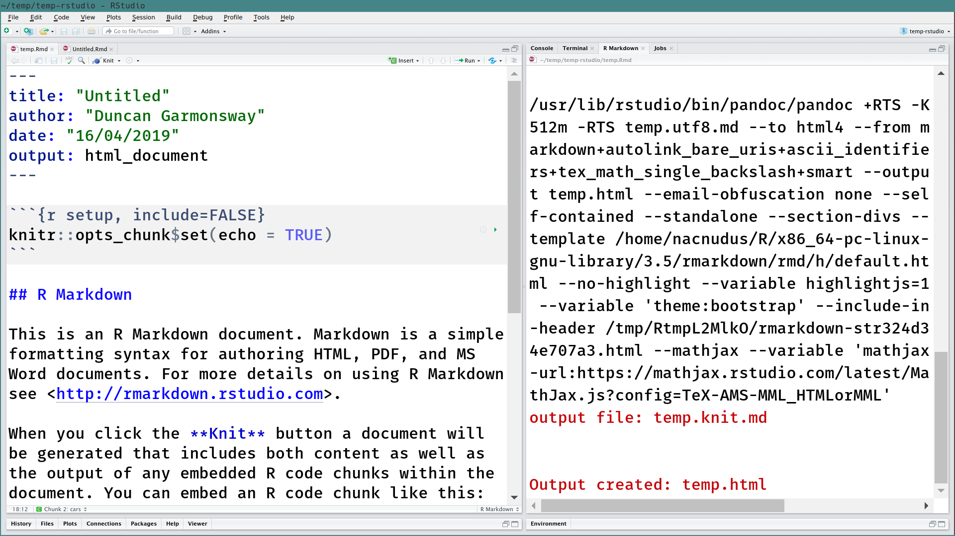
Notes:
To find out how something works, try something and see what happens. This slide shows the default R Markdown template being compiled to HTML. We have two leads, boxed in red. Html_document looks a lot like an R function. The gobblegook on the right looks like a command at the command line, calling a program called “pandoc” with a lot of arguments (“--something something”)
What does html_document do? Let’s look by typing it into the R console.

Slide 15
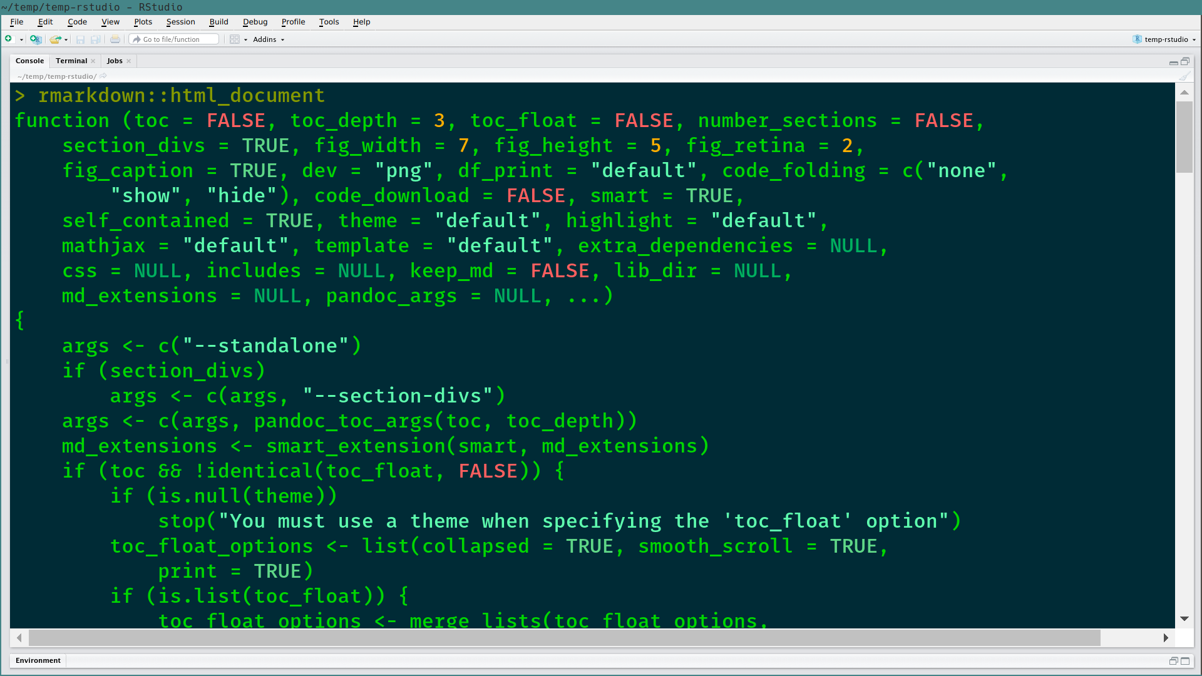
Notes:
When you type a function into the console without round brackets at the end, R shows you the code behind the function. I’ve made the background dark so that the green text is more readable.

Slide 16
Notes:
When you type a function into the console without round brackets at the end, R shows you the code behind the function. It’s in green -- not very accessible, but we won’t read it in much detail anyway.

Slide 17
Notes:
This is the interesting bit. What do you think it’s doing?

Slide 18
Notes:
It’s creating some of the arguments we saw before, to the pandoc command. In fact that’s almost the only thing that html_document() does. So to create our own version of the html_document() function, we’ll probably need to do something similar. We just need to work out what pandoc commands will create the webpage we want, and we can read the pandoc documentation for that.

Slide 19
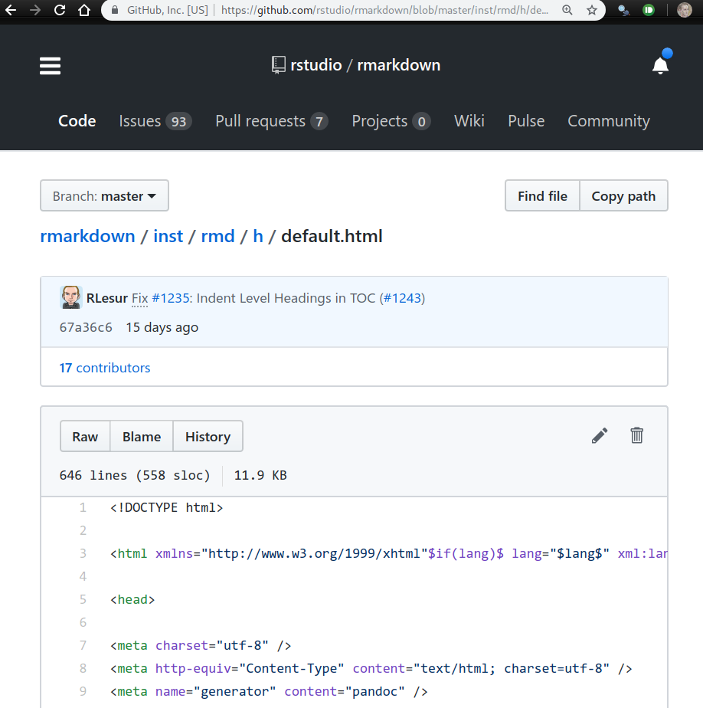
You can also read the source online
Notes:
It isn’t much fun reading source code in the console. It’s much easier in GitHub, and it’s easier to search there too. If this all looks like hard work, remember this is a privilege of open source technology: you can’t do this with Excel, SAS or SPSS.

Slide 20
The HTML template file is on my computer
Notes:
This is a fun one. By reading that call to pandoc, it turns out the HTML template that is being given to pandoc is somewhere on my computer. How did it get there? It was put there when I installed the rmarkdown package.
What other leads can we follow? We can look at the pandoc command in the console.

Slide 21

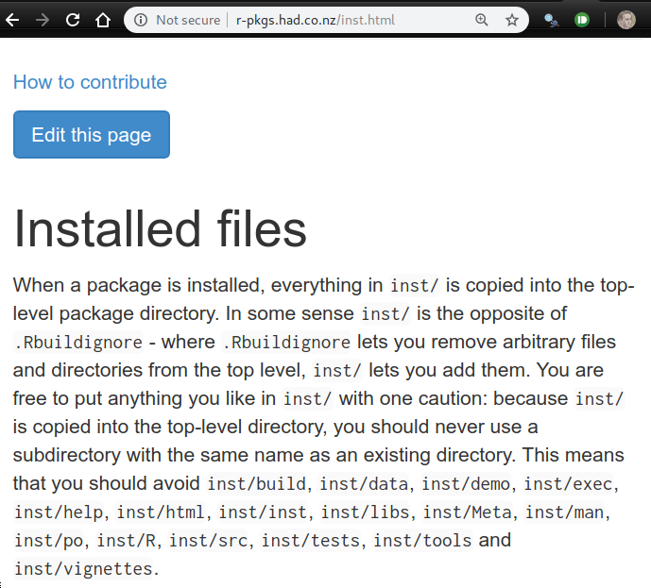
You can install files on users’ computers along with your package
Notes:
You too can install files on other peoples’ computers as part of your package. Read Hadley Wickham’s free online book “R Packages” to learn more. Please don’t abuse it!

Slide 22
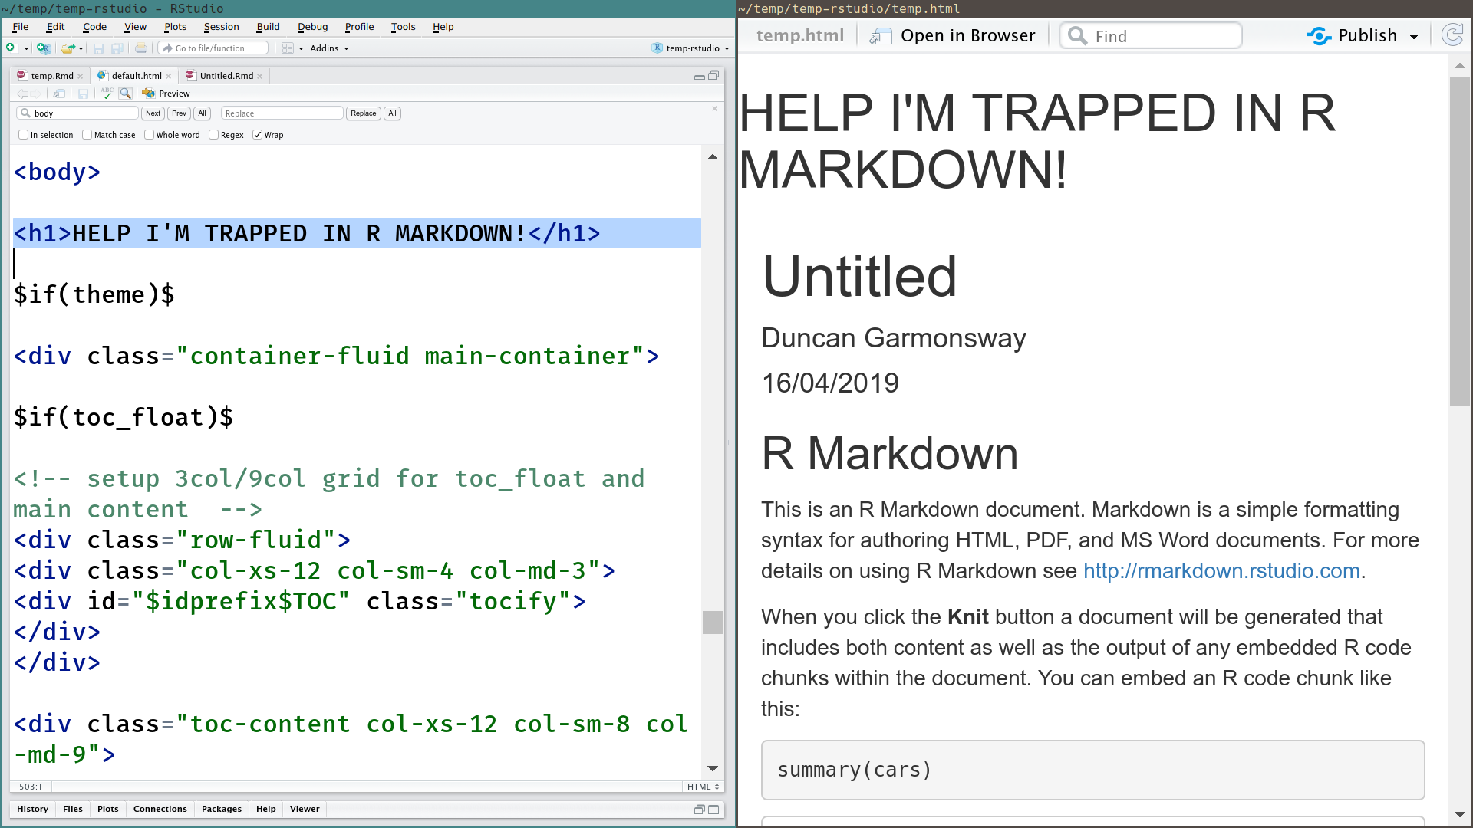
Notes:
What if you edit the HTML template? I added a level-1 heading to the top of the body of the page saying “HELP I’M TRAPPED IN R MARKDOWN” and then rendered the default R Markdown document. The message appeared in the rendered web page.
This is safe. If you break something, then recover by reinstalling the package.

Slide 23
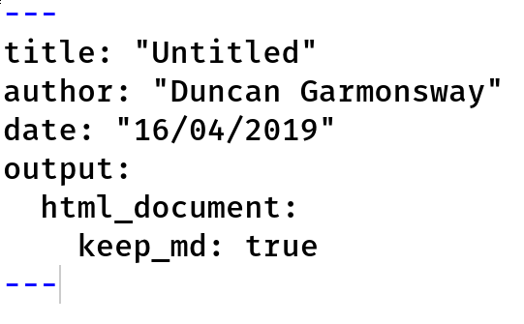
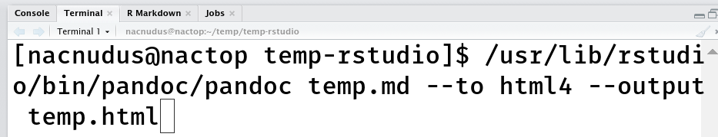
Run pandoc in the terminal and edit the arguments
Notes:
“keep_md: true” means that once knitr has run the code chunks and inserted their output into a plain markdown file, that markdown file is kept. The pandoc command is run on that markdown file.
Then in the terminal I ran the pandoc command, but I omitted most of the arguments. It only gets the input file, the instruction to make an html file, and the name of the html file.

Slide 24
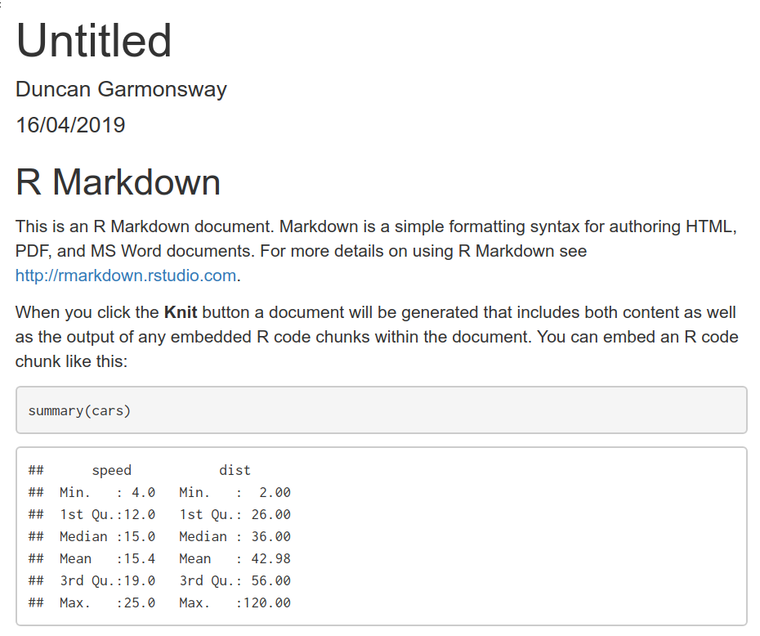
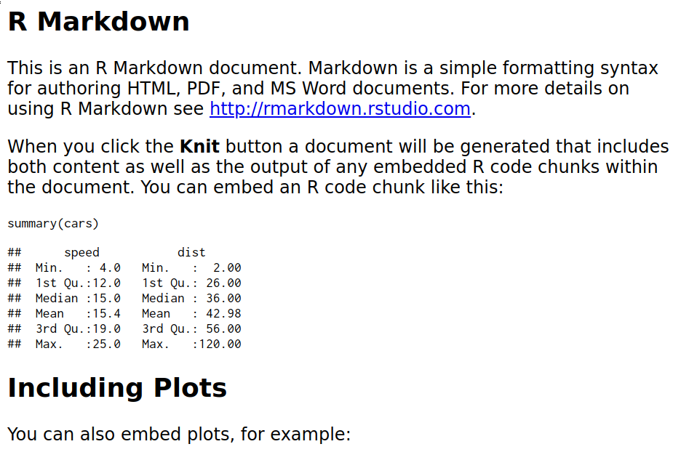
Default
Hacked
Notes:
Without all those pandoc arguments, the result looks very different.
It was quicker to iterate the pandoc command in the terminal than to build and reload a whole package, so I did most of the early development of govdown in the terminal.

Slide 25
Customising R Markdown
Notes:
This is what the talk was originally going to be about. I was going to customise R Markdown and then talk about how.

Slide 26
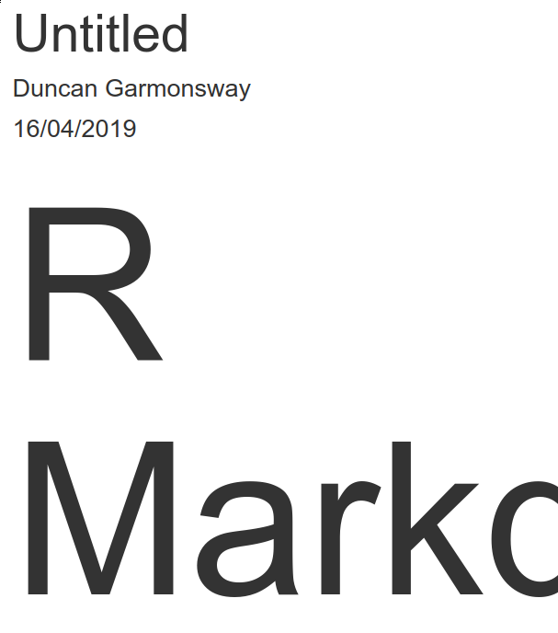
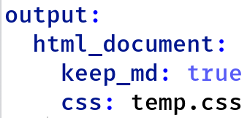
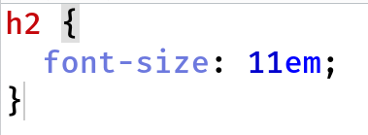
Custom css controls appearance
Notes:
The main tool on the web for controlling the appearance of a website is called CSS (cascading style sheets). You can give R Markdown a custom CSS file. Govdown does this differently so that you don’t have to do anything.
The GOV.UK Design System is basically a massive CSS file for styling ordinary HTML elements.
This example CSS looks for all <h2> elements (level-2 headers) and sets the font size to something very large.

Slide 27
The GOV.UK Design System CSS only works on elements with a particular ‘class’
Notes:
A snag is that the GOV.UK Design System CSS only works on elements with a particular class. The image shows a <div> element (a kind of section) with the class “govuk-inset-text”. Only div elements with that class will be styled. A div element with no class will be shown however the browser chooses.
And pandoc has no settings for adding classes to HTML elements. How can we get around that?

Slide 28
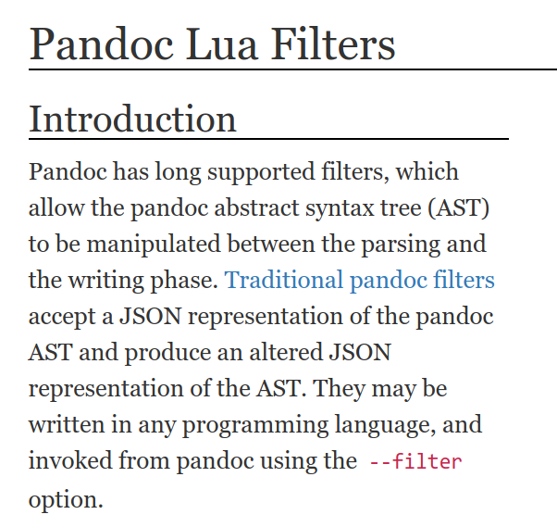
Lua is a language that can modify the way pandoc writes HTML
Notes:
Oh no, you have to learn yet another programming language: Lua. You already had to learn HTML and CSS. I’m sorry for you. But I need someone to help maintain {govdown}, and you don’t want to be outdone by the person from the Department for Transport who has already written some Lua for govdown.

Slide 29
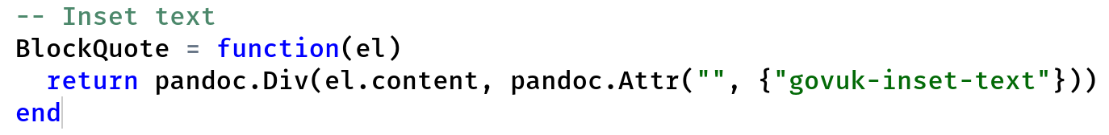
This is the Lua ‘filter’ to add a GOV.UK class to inset text
Notes:
Lua filters can be very simple. This one adds the class “govuk-inset-text” to a <div> element, which is what the GOV.UK Design System requires.

Slide 30
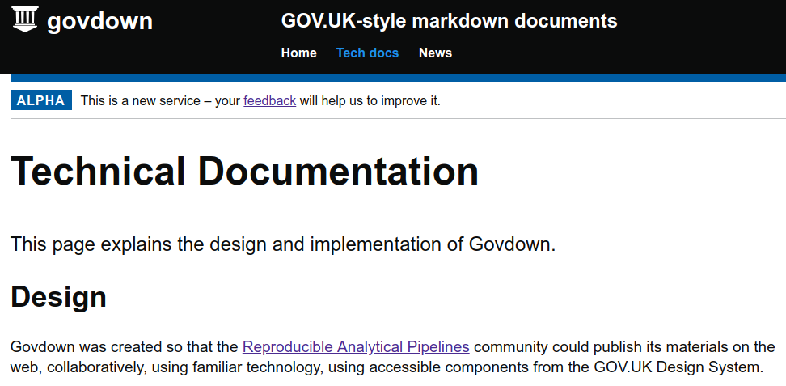
Learn more about Lua filters on the {govdown} website
Notes:
Lua filters can be very simple. This one adds the class “govuk-inset-text” to a <div> element, which is what the GOV.UK Design System requires.
https://ukgovdatascience.github.io/govdown/index.html

Slide 31
Thanks!
Duncan Garmonsway
@nacnudus
Notes:
What's next? Shiny? Whitehall Publisher?

